Slide 1
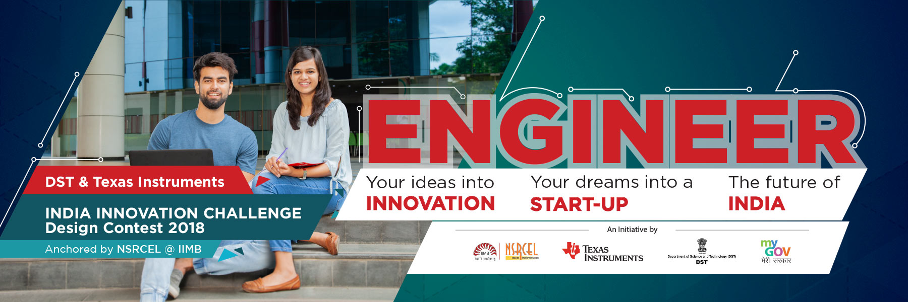
DST & Texas Instruments India Innovation Challenge Design
Contest 2018 Anchored by IIM Bangalore
Quarter Finals Technical Proposal

Slide 2


Automated Guidance System for Motor Vehicles Team 390003
Team Members:
Mayank Baranwal
Utkarsh Jain
Nitin Chauhan
Srijan Sankrit
Prateek Manocha
Mentor:
Dr. Gaurav Trivedi
Assistant Professor,
IIT Guwahati
Indian Institute of Technology, Guwahati

Slide 3

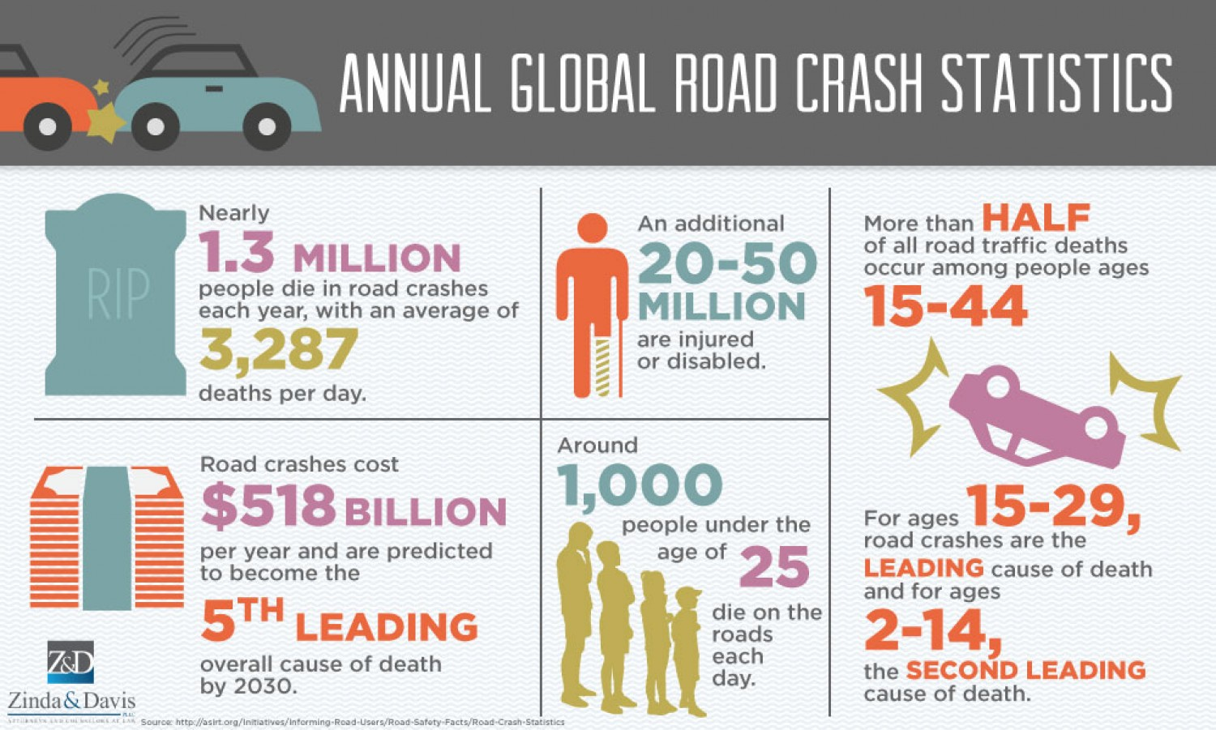
Product Inspiration
Road collisions is one of the leading causes of preventable death in India
Annually, 150,000 citizens of India lose their lives in motor vehicle accidents
55,000 crore (3% of Indian GDP) is lost through road accidents.
Immense social impact on families and corporations
Human error is the primary cause of motor vehicle accidents

Slide 4
Components Used
TI Components
Beagle Bone Black (Texas Instruments BBONE-BLACK-4G )
E-VASP NE552 Low Noise Audio Operational Amplifier Texas Instruments – x2
PTN78060WAH buck Boost Converter
Non-TI Components:
REES52 REES-1397 Single-Point TFmini Micro Ranging Lidar
REES52 Ultrasonic Range Finder Module Sensor
Camera Module
Speakers
Lithium Polymer Battery

Slide 5
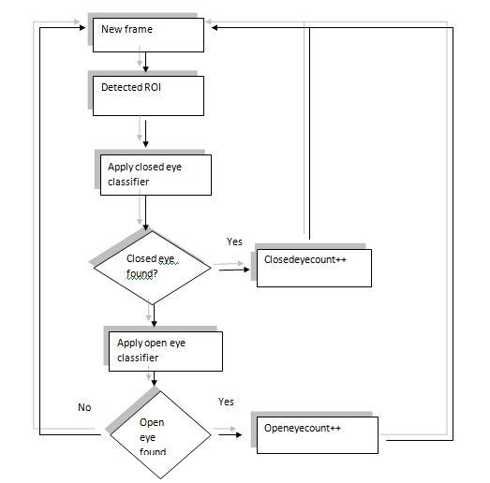
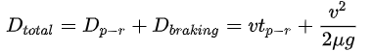
Internal and External Monitoring
Internal monitoring
Trained multi-stage Haar Cascade to locate face and open eyes in the region of face
External Monitoring
BBB uses LIDAR and odometer input to calculate min braking distance
Alarm sounded if limit breached or eyes close

Slide 6
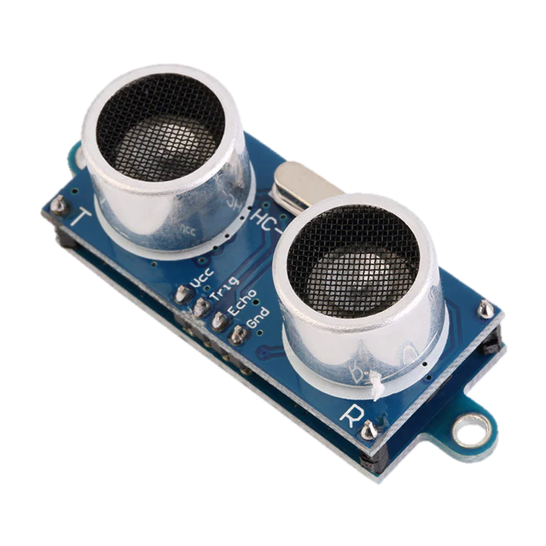
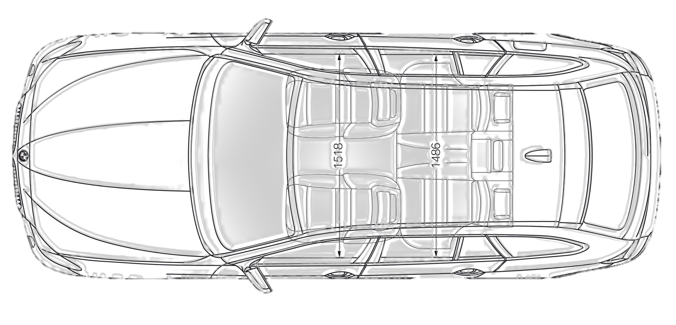
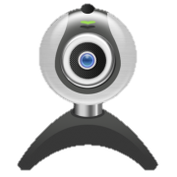
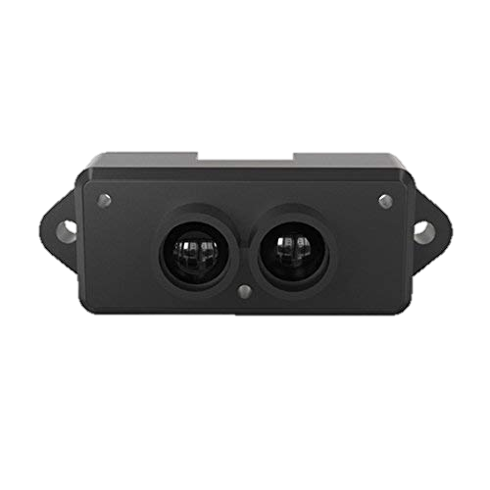
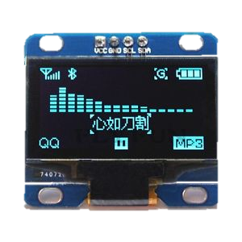

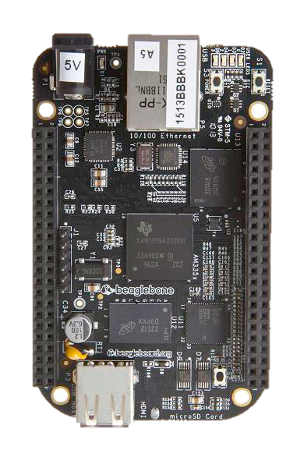

Product Vision
Ultrasonic Sensor
Camera
Lidar Sensor
LCD Screen
Micro Speakers
Beagle Bone Black
Ultrasonic Sensor

Slide 7
Thank You!

